Slide 1
Inheritance
Course Code: CSC1205
Course Title: Object Oriented Programming -1(JAVA)
Dept. of Computer Science
Faculty of Science and Technology
Lecturer No: |  | Week No: | 5 | Semester:
Lecturer: | Sifat Rahman Ahona, ahona@aiub.edu

Slide 2
Lecture Outline
Inheritance definition and example
Different types of Inheritance
Constructor chaining
this and super keyword
Method Overriding in inheritance

Slide 3
Inheritance
Definition of Inheritance
Inheritance is the mechanism of creating a new class by using an existing class.
Inheritance is used for code reusability.
To implement parent-child relationship.
The existing class that has been used to create a new class is known as parent class/ super class/ base class.
The new class that has been created from an existing class is known as child class/ sub class/ derived class.
Because of inheritance, a child class receives all the attributes and methods of the parent class.
In the example, Person is a parent class and Teacher is a child class.
Person
name,
age
Teacher
id,
roomno

Slide 4
Inheritance
Definition of Inheritance
A class can be defined as a "subclass" of another class.
The subclass inherits all data attributes of its superclass
The subclass inherits all methods of its superclass
The subclass can:
Add new functionality
Use inherited functionality

Slide 5
Inheritance
Definition of Inheritance
When an object is created using new, the system must allocate enough memory to hold all its instance variables.
This includes any inherited instance variables
In this example, we can say that an Employee "is a kind of" Person.
An Employee object inherits all of the attributes, methods and associations of Person

Slide 6
Inheritance
Definition of Inheritance
Person
- name: String
- dob: Date
Person
name = "John Smith"
dob = Jan 13, 1954
Employee
name = "Sally Halls"
dob = Mar 15, 1968
employeeID = 37518
salary = 65000
startDate = Dec 15, 2000
is a
Employee
- employeeID: int
- salary: int
- startDate: Date
What really happens?

Slide 7
Inheritance
Inheritance is declared using the "extends" keyword
If inheritance is not defined, the class extends a class called Object
public class Person
{
private String name;
private Date dob;
[...]
Person
- name: String
- dob: Date
public class Employee extends Person
{
private int employeID;
private int salary;
private Date startDate;
[...]
Employee
- employeeID: int
- salary: int
- startDate: Date
Employee anEmployee = new Employee();

Slide 8
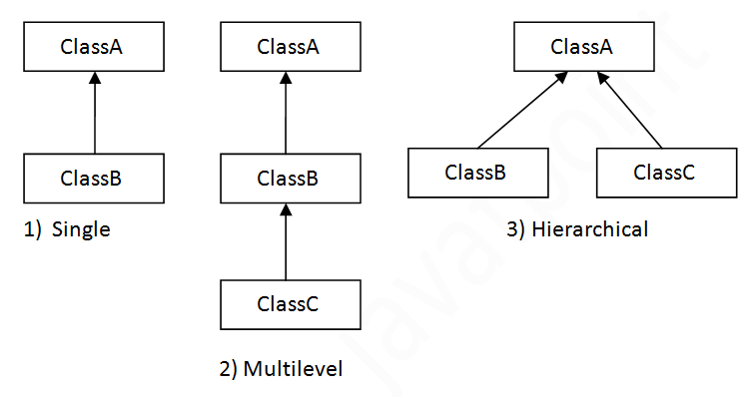
Inheritance
Types of Inheritance
4) Multiple
Not Possible
ClassA
ClassB
ClassC

Slide 9
Inheritance
Types of Inheritance
Possible
ClassA
ClassG
ClassB
ClassC
ClassE
ClassD
ClassF

Slide 10
Types of Inheritance
There is no limit to the number of subclasses a class can have
There is no limit to the depth of the class tree.
Each Java class has one (and only one) superclass.
C++ allows for multiple inheritance

Slide 11
Inheritance
Creating an object of a child class
We know that, whenever we create an object of a class, a constructor of that class is called.
So, Whenever we create an object of a child class, a constructor of the child class is called, but before executing the first statement inside the child class constructor, by default, the empty constructor of the parent class is called.
If, we want to call the empty constructor of the parent class by ourselves, we can do it by using the keyword super. Example: super( ).

Slide 12
Inheritance
Creating an object of a child class
If, we want to call any parameterized constructor of the parent class, we can do it by passing respective values inside the parameter of the keyword super. Example: super( . . . .).
The statement of super( ) or super ( . . .) MUST be the first statement inside the child class constructor.
We can also use the super keyword to refer to any attribute of method of parent class. Example: super.attributeName or super.methodName( ).

Slide 13
Inheritance
Calling same class constructor
Now that we know about calling parent class constructors, we now need to know how can we call a constructor of the same class?
We can call the empty constructor of the same class by using the keyword this. Example: this( ).
If we want to call a parameterized constructor of the same class, we have to pass respective values inside the parameter of the keyword this. Example: this(. . . ).
The statement of this( ) or this(. . .) MUST be the first statement inside the constructor.
We can also use the this keyword to refer to the attributes or methods of the same class. Example: this.attributeName or this.methodName( ).

Slide 14
Inheritance
Summary – this keyword and super keyword
this keyword:
Calling same class empty constructor → this( )
Calling same class parameterized constructor → this(. . .)
Referring same class attribute or method → this.
super keyword:
Calling parent class empty constructor → super( )
Calling parent class parameterized constructor → super(. . .)
Referring parent class attribute or method → super.

Slide 15
Constructors and Initialization
Classes use constructors to initialize instance variables
When a subclass object is created, its constructor is called.
It is the responsibility of the subclass constructor to invoke the appropriate superclass constructors so that the instance variables defined in the superclass are properly initialized
Superclass constructors can be called using the "super" keyword in a manner similar to "this"
It must be the first line of code in the constructor
If a call to super is not made, the system will automatically attempt to invoke the no-argument constructor of the superclass.

Slide 16
Constructors - Example
public class BankAccount
{
private String ownersName;
private int accountNumber;
private float balance;
public BankAccount(int anAccountNumber, String aName)
{
accountNumber = anAccountNumber;
ownersName = aName;
}
[...]
}
public class OverdraftAccount extends BankAccount
{
private float overdraftLimit;
public OverdraftAccount(int anAccountNumber, String aName, float aLimit)
{
super(anAccountNumber, aName);
overdraftLimit = aLimit;
}
}

Slide 17
Method overriding - Example
public class BankAccount
{
private String ownersName;
private int accountNumber;
protected float balance;
public void deposit(float anAmount)
{
if (anAmount>0.0)
balance = balance + anAmount;
}
public void withdraw(float anAmount)
{
if ((anAmount>0.0) && (balance>anAmount))
balance = balance - anAmount;
}
public float getBalance()
{
return balance;
}
}

Slide 18
Method overriding - Example
public class OverdraftAccount extends BankAccount
{
private float limit;
public void withdraw(float anAmount) // Overriding method
{
if ((anAmount>0.0) && (getBalance()+limit>anAmount))
balance = balance - anAmount;
}
}

Slide 19
Books
1. Java Complete Reference, 7th Edition, By Herbert Schildt.
2. A Programmer's Guide to Java SE 8 Oracle Certified Associate, Khalid A. MughalRolf W. Rasmussen
3. Java How to Program Java, 9th Edition, By Deitel and Deitel.
4. The Java Language Specification, By J. Gosling, B. Joy, G. Steele, G.Bracha and A. Buckley
5. Introduction to Programming Using Java, 6th Edition, By David j. Eck
6. Head First Java, By Kathy Sierra and Bert Bates

Slide 20
References
1. 1. Java Complete Reference, 7th Edition, By Herbert Schildt.
2. A Programmer's Guide to Java SE 8 Oracle Certified Associate, Khalid A. MughalRolf W. Rasmussen
2. The Java Tutorials. http://docs.oracle.com/javase/tutorial/

